Slide 1
Music
Chris Hoorn, Tiffany Pohl, Cody Plungis
Notes:
Let them answer question 1.

Slide 2
Domain Track
Required Courses:
SV 244 Music History: Medieval, Renaissance, Baroque
IA 246 Music Theory I
MUS 113 Music Skills I (Indiana State University course)
MUS 150 Introduction to Musical Traditions I (Indiana State University course)
No longer a suggested domain track
Notes:
Sources: http://www.rose-hulman.edu/Catalog1011/program-se.html
Time: 0:20
Cody
This domain track is no longer really listed, but it is pretty easy to add domain tracks, so if somebody really wanted to do this domain track, I am sure they could.

Slide 3
What is Music Software?
Music Recognition Software
Recording Software
Sampling Software
Audio Editing Software
Notation Software
DJ Software
Tuners
Notes:
Sources: http://www.music-software-reviews.com/index.html
Time: 2:00
Cody
Music Recognition – Takes audio input, usually from a microphone like on a phone, and processes it down to just a fingerprint. This fingerprint is then compared to a very large library of fingerprints that are known to find a match.
Recording – Software used to record input from various forms. Examples include direct output from an instrument, a microphone, and MIDI data. The software then usually allows for some editing and rearranging of the recorded audio.
Sampling – This software is similar to recording software, but it is not usually used to record longer pieces of audio. Samples are usually short. Often this software is also able to generate sounds which can be recorded for later use.
Audio Editing – This is usually used to arrange prerecorded tracks into a song. There is also usually the ability to apply various filters to fine tune the sound. This software then has the ability to write all of the information to one of any variety of music file formats.
Notation – This software is used by musicians to write down sheet music.
DJ – This software is used to mix songs together in various ways. This also usually includes faders to fade between songs and filters to change the way the song sounds.
Tuners – This software provides a set sound that you can tune other instruments against. This is quite useful when trying to make a bunch of instruments all sound the same.
Also, some of this software requires special hardware to interact with other equipment.

Slide 4
Define Quality
Differs depending on the product
Usability
Efficiency
Correctness
Testability
Flexibility
Reliability
Notes:
Sources: http://www.musicmall-asia.com/minni/Papers/costam99jtlm.pdf
Time: 2:00
Cody
The different aspects are not only measured differently for different products, but typically what is important also varies.
Usability – Simply how easy the software is to use
Efficiency – How much system resources does it take to complete a given action.
Correctness – How well does the system do what it is supposed to do.
Testability – How easy it is to test the program.
Flexibility – How easy it is to do various actions. How many ways can you do the same action. How many different formats can you take as input or give as output.
Reliability – How likely the software is to break or produce errors.
Let them answer question 2.

Slide 5
Quality Attributes
Recognition Software
Success Rate
Large Library
Recording, Writing, and Editing Software
Attractive Interface
Arrangement of menus and buttons
Representation of Music
Easy to Use
Single click actions
Helpful Labels
Large Feature List
Accurate Emulation of Music
Sound Quality
Sampling Rate
Notes:
Sources: http://www.music-software-reviews.com/index.html, ttp://www.musicmall-asia.com/minni/Papers/costam99jtlm.pdf
Time: 2:00
Cody
Recognition Software – Good Recognition software usually has two related qualities: A high success rate and a large library. Typically in order to have a high success rate you need a large library, but the converse is not necessarily true.
Recording, Writing and Editing
Interface – The interface needs to be visually appealing to draw people in and make them want to try to use the program. The interface must also be easy to understand so people are not overwhelmed by the learning curve. The interface should also display information in an efficient and easy to understand manner.
Easy to Use – The program should be arranged in a way that it is easy to understand how it works and that an experienced user can easily access all of the functions that they need to frequently use.
Large Feature List – The software should also support a lot of different features so that users can use it for almost everything that they need to do.
Accurate Emulation of Music – The software needs to be able to output excellent quality music. The quality is not completely dependent on the software, but the software should not be the limiting part of quality. Also the software should allow for the output of many formats at many different levels of bitrate.

Slide 6
Determining Quality
Done through rigorous testing
Technical Testing
Audio Timing
MIDI Timing
Load Testing
Handling and Feature Tests
Setup
Recording
Arrangement
Automation
File Handling
Libraries
Intelligence and Ease
Notes:
Sources: http://www.music-software-reviews.com/recording_software_tests.html
Time: 3:00
Tiffany
Audio Timing – All recording system has some delay. Insignificant in analog domain, different story in digital world, problem also called latency Use audio timing to determine how much of a delay.
Midi Timing – Is not as exact as audio tracks. Delays of 1ms and up can be a problem for percussive signals.
Load Testing – How many tracks can the software handle simultaneously?
Setup – Does everything work? How easy is it to use and understand?
Recording – How many steps / clicks does it take to record something? Are there any features that might be needed (cycle, loop)
Arrangement – How does the cutting audio work? Is it precise? Is there overlap?
Automation – How easily can things be automated? (Things such as volume, fade, jump in track, record, etc)
File Handling – Where are files stored and how secure are they? Can they easily be names and moved? Importing and Exporting.
Libraries – Are there a wide range of templates available?
Intelligence and Ease – Is it easy to build songs? Is it possible to create your own styles?
Let them answer question 3.

Slide 7
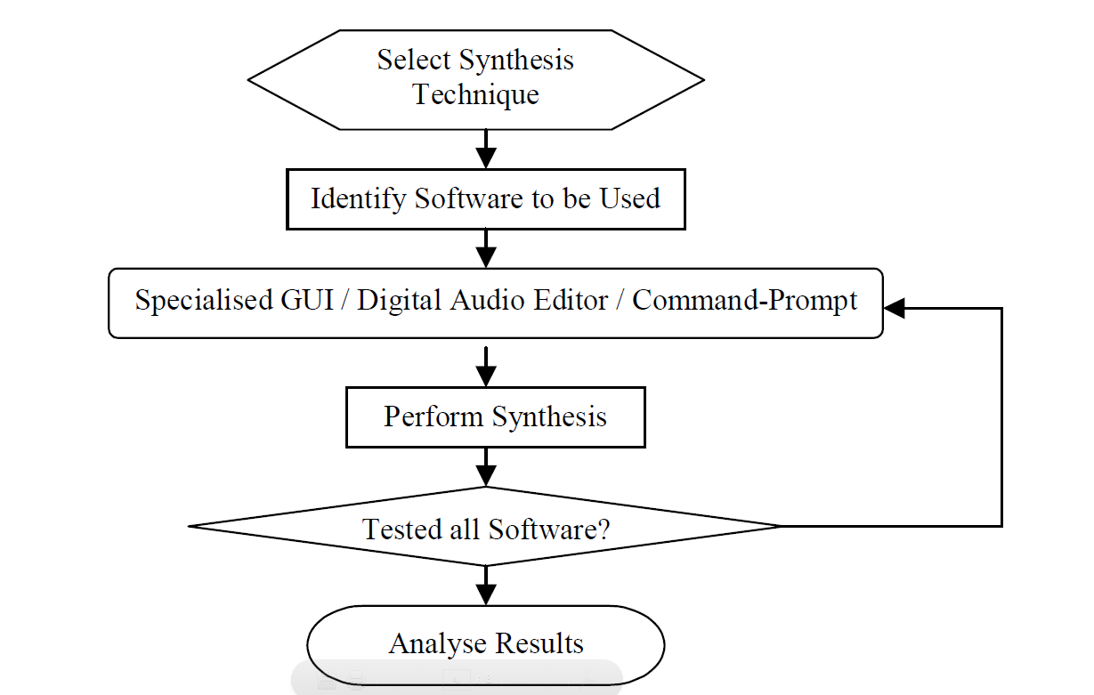
Testing Cycle
Notes:
Sources: http://www.musicmall-asia.com/minni/Papers/costam99jtlm.pdf
Time: 0:20
Tiffany
Basic testing cycle for music software.
What type of editing are you wanting to do? Determine software that would be ideal for this.
Identify type of wave and frequency.

Slide 8
Metrics
Usability
Menu Levels, Shortcut Keys, and Functions
Tutorials, Help Files, and Web Support
Efficiency
Processing Time
Memory Usage
Testability
Questionnaires & Surveys
Flexibility
Customizing Parameters
Supported Formats
Reliability
Sampling Rate
Correctness
Bugs and Error Logs
Notes:
Sources: http://www.musicmall-asia.com/minni/Papers/costam99jtlm.pdf
Time: 1:00
Tiffany
I’m just going to go off of this slide. There is a lot of information here that could easily take a minute to cover.
Let them answer question 4.

Slide 9
Suggested Processes
Testing as a developer practice
Involve musicians in design process
Balance Form and Functionality
Tailor the product to the user
Notes:
Sources: Me
Time: 1:00
Tiffany
1.) Developers should be testing everything throughout the development process.
2.) Involving musicians will help achieve what the customers want. It will also help with the quality of playback.
3.) Provide all needed functionality while keeping the interface in an easy to use state.
4.) Make sure the product is easy to use, not all people using it will be super technical.

Slide 10
Suggested Metrics
Options/Menu
Features/Unit Area of GUI
Scaling Factor
Actions/Feature
Quality deterioration over number of copies/edits
Memory use per instrument or per second of data
Reliable range
Simultaneous sampling rates
Sounds/Sample
Notes:
Sources: Me
Time: 2:00
Chris
Apart from those metrics already listed in a previous slide, I would suggest anyone engaged in the development of music software to track the following metrics as they pertain to their particular software product.
Options/Menu: Cluttered menus can be overwhelming, especially to those with limited computer experience. The number of items on menus and submenus should be limited so as not to discourage users, yet useful enough to avoid redundancy.
Features/Unit Area of GUI: For the same reasons, developers should limit the number of items on screen at any time. This metric is slightly dependent on the product however. Having many easily accessible features is important in some music software, such as DJ equipment and Controllers. This being said, the display should never be cluttered with too many buttons and knobs.
Scaling Factor: In recording and editing software, how well the product is able to perform zooms and amplifications.
Actions/Feature: In contrast to having too many features on the screen at one time, it is important to have easy access to certain features. This metric measures the number of clicks or actions the user must take to perform a function. Heavily used functions should require a low number of actions.
Quality deterioration: As sections of an audio file are copied, stretched, amplified, and otherwise edited their quality is sometimes deteriorated. The metric would be measured as a percentage based on number of faults or errors per unit of time.
Memory use per instrument or second of data: In the area of recording and sampling, memory should be allocated efficiently for the data collected. Using certain techniques such as pitching and looping can reduce memory use when recording and mimicking audio.
Reliable range: In listening software this would refer to the range of volumes and pitches the software is capable of recording and replaying reliably. In editing software this metric could pertain to the amount of stretch and amplification the program is capable of applying to a file without losing the audio sample’s quality.
Simultaneous sampling rates: Different audio files are likely recorded at different sampling rates. This metric tells us how many files of different sampling rates a program is able to mix effectively.
Sounds/sample: In sampling software, a number of sounds can be created from a single sample. This measures the measures the number of pitches and tones a sampler is able to make based on a single recorded tone.
If they have not answered question 4, they should now.

Slide 11
Industry Successes
Music Recognition Software
Shazam
Notation Software
Finale and Sibelius
Recording Software
Pro-Tools by Digidesign
Sampling Software
Gigasampler/Gigastudio
Editing Software
Sony’s Sound Forge
DJ Software
MaxVibes
Notes:
Sources: http://www.music-software-reviews.com/index.html, http://www.quora.com/Music-Recognition/What-are-the-best-music-recognition-technologies-products-or-services
Time: 1:00
Chris
Listed are some of the most successful ventures in the realms of music software.
In 2002 Shazam became the first freely available mobile music recognition software. Since then it has become the one of the top 10 most downloaded apps on the ITunes store. Shazam has recently begun to expand its world famous music recognition software to TV programming, their vision being to allow shazam users to access secret content through recording certain portions of television advertisements. This feature has been used during a superbowl commercial and Old Navy has brought Shazam on board for their new ad program.
Finale and Sibelius are the top two competing notation software programs. Finale is used by many students taking Rose-Hulman’s secondary music theory course. Both programs allow users to write and replay their own songs. Finale is the preferred software for those writing classical music, while Sibelius is favored by Jazz musicians.
Pro-Tools is the top of the line in audio recording software. The HD system is capable of simultaneously recording up to 192 tracks and comes with its own DSP to limit stress on the computer. The LS version records up to 8 tracks at a time. They are compatible with several different interfaces and 5 methods of control.
Gigastudio, an evolutionary form of the original world-famous Gigasampler, is the top of the line in sampling software. Capable of emulating an enormous array of the most natural sounding instrument sounds, Gigastudio also has extremely low latency and contains advanced convolution technology. Strangely it is only available on PC.
Sony has made available a wide range of audio editing software known as Sound Forge. Available for any level of editor, Sound Forge digital audio editing software includes a powerful set of audio processes, tools, and effects for manipulating audio. Sound Forge software allows you to edit, record, encode, and master nearly any form of digital audio including WAV, AIFF, and MP3 files.
MixVibes’ Cross and VFX software is used around the world by some of the most well known DJs. Their systems are starting to be developed for the Ipad as well.

Slide 12

Industry Failures
Notes:
Sources: http://www.pcworld.com/article/158300/microsoft_songsmith_bad_music_made_easy.html
Time: 2:00
Chris
Songsmith was created by Microsoft in 2009 as a product that would revolutionize the way we made songs. It’s goal was simply to make writing a song as simple as possible. Songsmith works by recording a person’s voice, then matching music to the voice based on frequency and selected style. The resulting product was not well received by those with any sort of experience in music development. When writing songsmith, Microsoft fell into a common trap: while they accomplished their goal for simplistic song creation, it seems as though the quality of the song was somewhat of a second thought. The MIDI tracks used by Songsmith to accompany users voices are some of the most fake sounds imaginable and the chord detection algorithms used by the program are easily confused, resulting in odd song mixes. In addition to stale audio, Songsmith’s lack of features and customization options don’t allow real editing of the recorded songs either. Intended for use by everyone, even professionals, Songsmith has instead fallen somewhere between a joke and kid’s toy.

Slide 13
Songsmith + Roxanne
Notes:
Sources: http://www.youtube.com/watch?v=xWYwY8GpuO0
Time: 0:30
Chris
This is an example of how Songsmith can often apply odd audio tracks to recorded voices. The song Roxanne is recorded and given to Songsmith, which then uses its algorithm to choose an accompanying audio track. The result is something similar to that of Mario Kart 64.

Slide 14
Industry Standards
Audio Engineering Society (AES)
Mission Statement:
“The Audio Engineering Society was formed with the purpose of uniting persons performing professional services in the audio engineering field and its allied arts, of collecting, collating and disseminating scientific knowledge in the field of audio engineering and its allied arts, of advancing such science in both theoretical and practical applications, of preparing, publishing and distributing literature and periodicals relative to the foregoing purposes and policies.”
Notes:
Sources: http://www.aes.org/
Time: 1:00
Chris
The Audio Engineering Society is the only professional society devoted exclusively to audio technology. Founded in the United States in 1948, the AES has grown to become an international organization that unites audio engineers, creative artists, scientists and students worldwide by promoting advances in audio and disseminating new knowledge and research.
Mission Statement:
“The Audio Engineering Society was formed with the purpose of uniting persons performing professional services in the audio engineering field and its allied arts, of collecting, collating and disseminating scientific knowledge in the field of audio engineering and its allied arts, of advancing such science in both theoretical and practical applications, of preparing, publishing and distributing literature and periodicals relative to the foregoing purposes and policies.”
The standards and practices documents are unavailable to non-members and are expensive to aquire even for those with membership.
Let them answer question 5

Slide 15
QA Issues
Musical quality can be very subjective
Quality Assurance requires a diverse team
Quality is very dependent on hardware
Form vs. Function
Notes:
Sources: Me
Time: 1:00
Chris
When assessing music software, it is sometimes difficult to say what effects are good and bad. Music itself is an art form, and the software is geared to be artistic. The quality of a piece of art is very subjective, what appears or sounds good to one person, may be seen as awful to another. A quality assurance team should therefore be very diverse. For example, having software developers assessing the quality of a sound byte may prove to be less appropriate than if a few music proffessionals were involved in the QA process.
Another issue facing quality assurance of some music software is the dependence on audio hardware. The software can only be as good as the associated hardware, and these programs are made to be compatible with a broad array of said hardware. It is sometimes difficult to perform tests on the software when the quality of the hardware is unknown or unreliable.
Lastly, when determining the quality of a music software product, it is important to understand the goal of the product. This is different for every project, but the focus of the developers in terms of style vs function must be known if the QA team is able to determine the overall quality of the product. For music software a focus on style is rather more important than for some software products.

Slide 16
Questions?
Notes:
Sources: Me
Time: 1:00

